Slide 1


Visualizing Neural Networks
An Intuitive Journey into Deep Learning
Ashish Mishra
May 2026

Slide 2

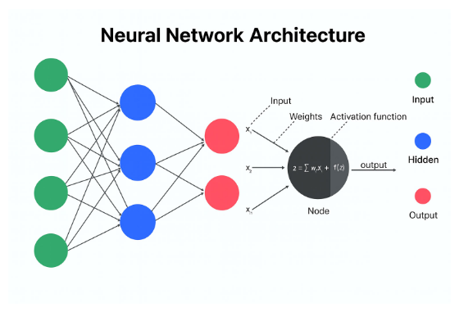
What is a Neural Network?
"A neural network is a machine learning model inspired by the human brain. It processes data through layers of interconnected neurons to identify patterns and make predictions."
By combining millions of simple mathematical nodes in layers, the network is capable of learning complex abstractions, such as identifying objects in images or understanding human language.

Slide 3
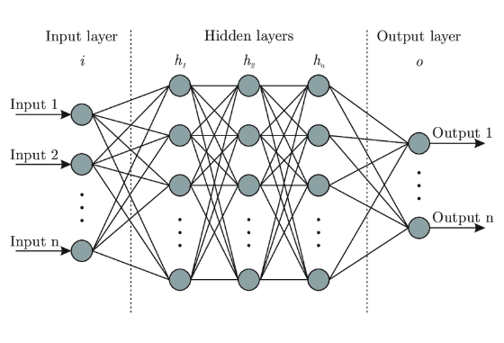



Layers: Structuring Data Flow
Receives raw features from datasets (such as individual pixels, audio waves, or structured fields) and serves as the entry point of the network.
Intermediary processing blocks. They dynamically extract increasingly abstract features, learning nonlinear relationships.
The final layer that converts processed representations into concrete predictions, like class categories or regression targets.

Slide 4


Neurons: Core Computation
The Mathematical Model
Processing Units
Each neuron behaves as an elegant mathematical operator processing multi-dimensional coordinate vectors:
Neurons are the essential building blocks of AI. They receive continuous inputs from preceding layers, calculate their weighted sum, apply bias values, and filter the result using an activation function.

Slide 5

Weights: Determining Importance
Signal Strengths
Iterative Optimization
Weights control how strongly one neuron influences another. They act as the computational synapses inside a network. Higher positive values emphasize critical feature associations, while negative weights actively suppress noise.
During neural network training, parameters are initialized randomly. The network repeatedly calculates predictions, compares them to truth labels, and updates weight configurations across millions of paths to converge on accuracy.

Slide 6







Activation Functions
Nonlinearity
ReLU Function
Sigmoid Function
Allows neural networks to build curved decision boundaries. Without nonlinearity, deep neural networks collapse mathematically to simple linear equations, preventing them from solving high-complexity tasks.
The standard hidden layer function. It blocks all negative values by outputting zero ($x \le 0 \to 0$) and allows positive values to pass through without modification, solving vanishing gradient problems.
Often utilized in classification output layers. It squashes arbitrary numerical inputs into a smooth probability curve constrained strictly between 0 and 1, facilitating reliable confidence output.

Slide 7

Loss Functions: Measuring Error
The Error Metric
The Objective Function
Loss functions calculate how far model predictions deviate from actual truth data. This metric assigns a single, quantifiable cost score representing overall failure level, which guides standard training routines.
The overall goal of learning algorithms is to adjust network weights and biases until the calculated loss is as close to zero as mathematically possible. Lower loss numbers signify more precise predictions.

Slide 8



Optimization Algorithms
Gradient Descent
Adam Optimizer
Feedback Loops
Calculates the slope of the error curve and adjusts parameters in the downward direction. This allows the network to systematically seek the lowest point of total loss.
An adaptive optimization framework that calculates custom, varying step sizes for individual parameters. This accelerates learning and prevents model convergence stalling.
Through backpropagation, optimizers efficiently route mathematical derivatives backwards from output nodes to early input channels, seamlessly calibrating modern deep learning layers.

Slide 9
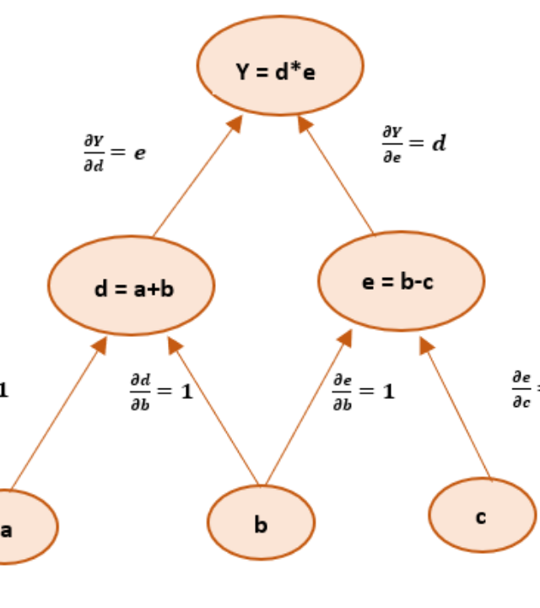
Network Architecture Flow
Structured Connectivity
Data flows from the input layer through hidden layers where patterns are learned before reaching the output layer.
Interconnected layer designs allow deep neural models to discover nested visual, linguistic, and behavioral associations.

Slide 10
Summary and Key Takeaways
Foundational Concepts
Personal Learnings
Developing neural network architectures is a balancing act. Correctly tuning layers, weights, biases, activations, and optimizers transforms chaotic raw inputs into highly accurate predictive intelligence models.
Exploring systems like the TensorFlow Playground demonstrates that deep learning elements are highly dependent: tweaking learning rates, background noise levels, and hidden layer configurations dictate the model's ultimate success.

Slide 11



Image Sources
https://ik.imagekit.io/upgrad1/abroad-images/imageCompo/images/ChatGPT_Image_Nov_20_2025_03_47_56_PMTT18DE.png
Source: www.upgrad.com
https://trivenisiteasset.blob.core.windows.net/trivenisiteasset-container/2021/10/ann.png
Source: triveniglobalsoft.com
https://media.geeksforgeeks.org/wp-content/uploads/20200527173723/e34.png
Source: www.geeksforgeeks.org

